Slide 1
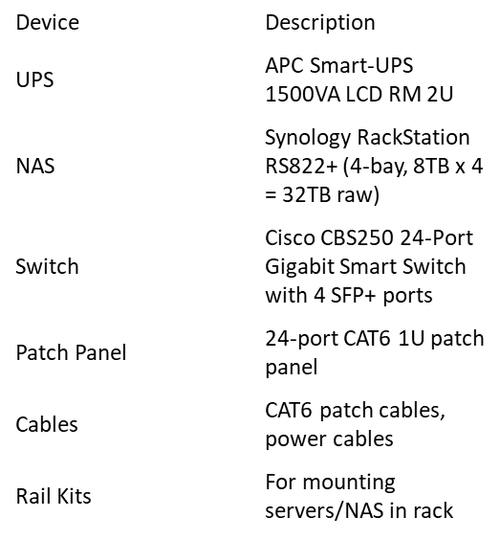
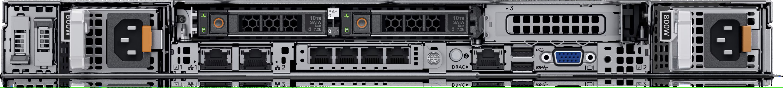
Server info:
Server: Dell PowerEdge R650
CPU: Dual Intel Xeon Silver 4314 (16 cores each) — 32 total cores
RAM: 256 GB DDR4 ECC RDIMM
Storage: 4 × 10TB SATA HDD (RAID 10)
Networking: Quad 1GbE NIC + 2 × 10GbE SFP+ (optional)
Power: Dual 800W PSU
Form Factor: 1U rack server
This will serve as the virtualization host (e.g. running VMware ESXi or Proxmox).
Other Hardware:
Notes:
All components are rack-mounted and dual-powered where possible.
The server hosts virtual machines (VMs) for services like email, web, files.
NAS is used for backup, file sharing, or VM datastore.
Redundant NICs and SFP+ are ready for high-performance networking.
UPS provides surge protection and limited runtime.
No external monitor/keyboard — managed via remote IPMI (iDRAC).
Up to 3x Pcle Gen4 slots, with SNAPI option and up to 2x 2.5” rear HDD/SSD or NVMe
Rear accessible and host pluggable BOSS S2
iDRAC9
Dual 800W PSU
Powe Rail A
VGA
Dual 800W PSU
Powe Rail B
2 × 10GbE SFP
Quad 1GbE NIC
USB 2.0 and 3.0

